Slide 1

Welcome to …
CNENGR506
Intelligent System Control

Slide 2
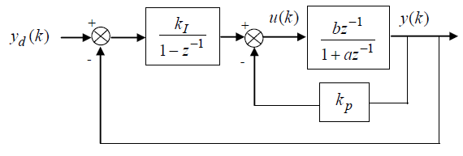
Example:
1. Find the closed-loop transfer function relating y(k) and y_{d}(k).
2. Find the steady state gain of the closed-loop system and comment on its significance.
3. Given the parameters of the ventilation model, i.e., a= -0.6 and b=3, Calculate the proportional and integral gains that yield closed-loop poles at 0.3 and 0.4 on the complex z-plane.
4. Given the parameters of the reservoir model now, i.e., a= -0.8 and b=0.2, calculate the control gains.
5. What are the limitations of PI controller? How these limitations can be address?

Slide 3
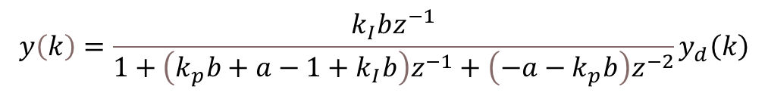
Solutions:
$$y\left(k\right)=\frac{k_{I}bz^{−1}}{1+\left(k_{p}b+a−1+k_{I}b\right)z^{−1}+\left(−a−k_{p}b\right)z^{−2}}y_{d}\left(k\right)$$
SSG = 1 hence there is steady state tracking of the set point
$$k_{p}=0.16$$
$$k_{p}=3.4$$
$$k_{I}=0.14$$
$$k_{I}=2.1$$

Slide 4
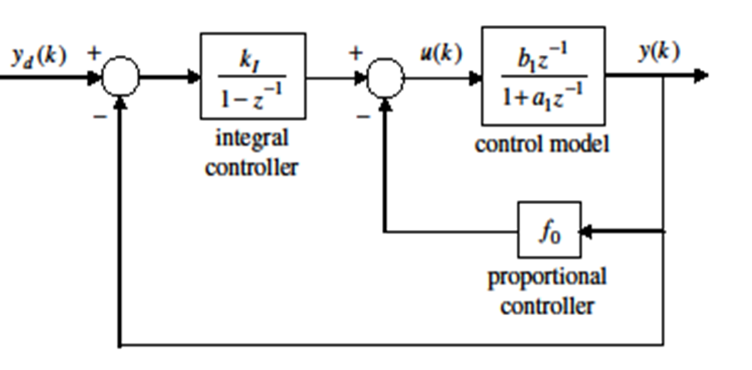
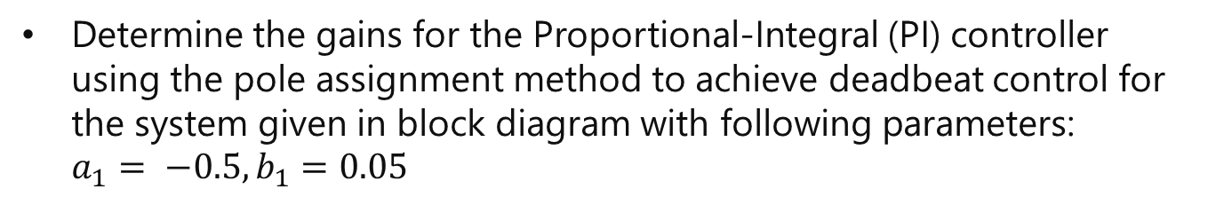
Question
Determine the gains for the Proportional-Integral (PI) controller using the pole assignment method to achieve deadbeat control for the system given in block diagram with following parameters: $a_{1}= −0.5, b_{1}=0.05$
Discuss the disadvantages associated with deadbeat control.
What are the limitations of PI controller? How these limitations can be addressed?

Slide 5
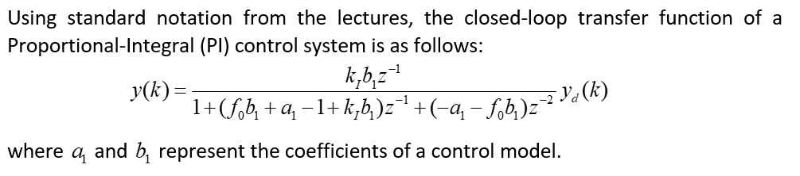
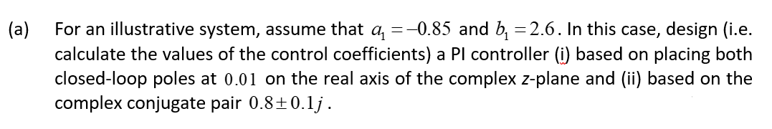
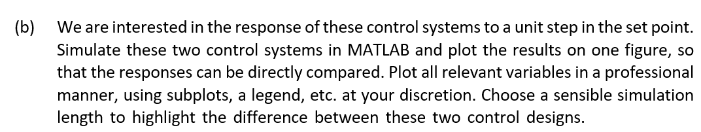
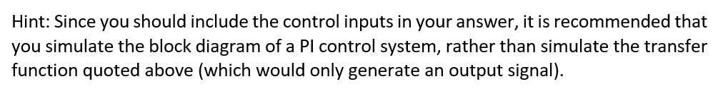
Example-2 (Homework)

Slide 6
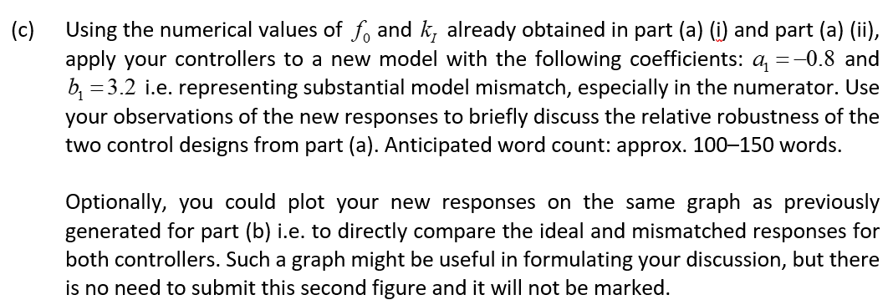
Example-2 (Cond…)
This work will be checked in the Lab on 27-10-2025

